Slide 1
Capstone Project by Lolade Folorunsho

Slide 2
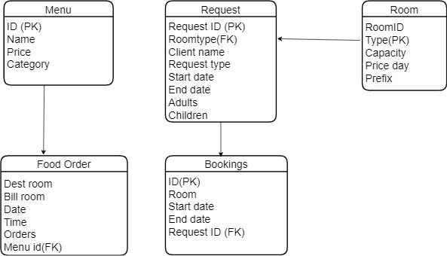





Entity Relationship Diagram

Slide 3
Entity Relationship Diagram Explained
Room Table: Captures the information about the different types of rooms available with their capacity and prices per day. Each row of the listed room type is uniquely identified by an ID
Request Table: Captures the information about guests who are put in requests for rooms including number occupants and date and time they want it. The table has RequestID as a primary key and room type which serves a foreign key that links it to room table thereby providing information about the type of room requested for
Bookings Table: Has information about guest who not only put in a request but followed through and eventually paid and booked the room. The table also has start and end dates and exact room. It is linked to the Request table by RequestID(FK)
Menu Table: Captures information about the different food options available and their prices. The table has an ID as a primary Key
Food Order: tells us the destination of ordered food, dates and times orders were placed. This table has information about the Billroom the order is charged to. However, because Billroom is not a PrimaryID, it is difficult to tell specifically the client that booked room where the food is billed to. Food order table could only be joined to the Menu table by the Menuid (foreign key) as this helps us to know the type and price of food ordered

Slide 4
Observations and Recommendations
The following observations made ETL transformation and Data Manipulation challenging and cumbersome:
Not all entities had a Unique Identifier(PK). No PK in food order table. This would've made joining to Room table easier
Every Entity Should have a Primary Key as Unique Identifier
Inconsistent dates in bookings table; some records had start and end dates year as 1916 instead of 2016
Proper date validation process to be introduced.
The requests entity should be split into more than a single entity. For example, Request table had information about Client
There should be an entity that contain more details of the guests.
Inconsistency attribute names on different tables, this made it difficult to link related attributes on each entity.
The attribute naming should be consistent especially for related attributes.
A lot of redundant attributes noted in most entities; like id in room table.
Only meaningful data should be included in dataset.

Slide 5
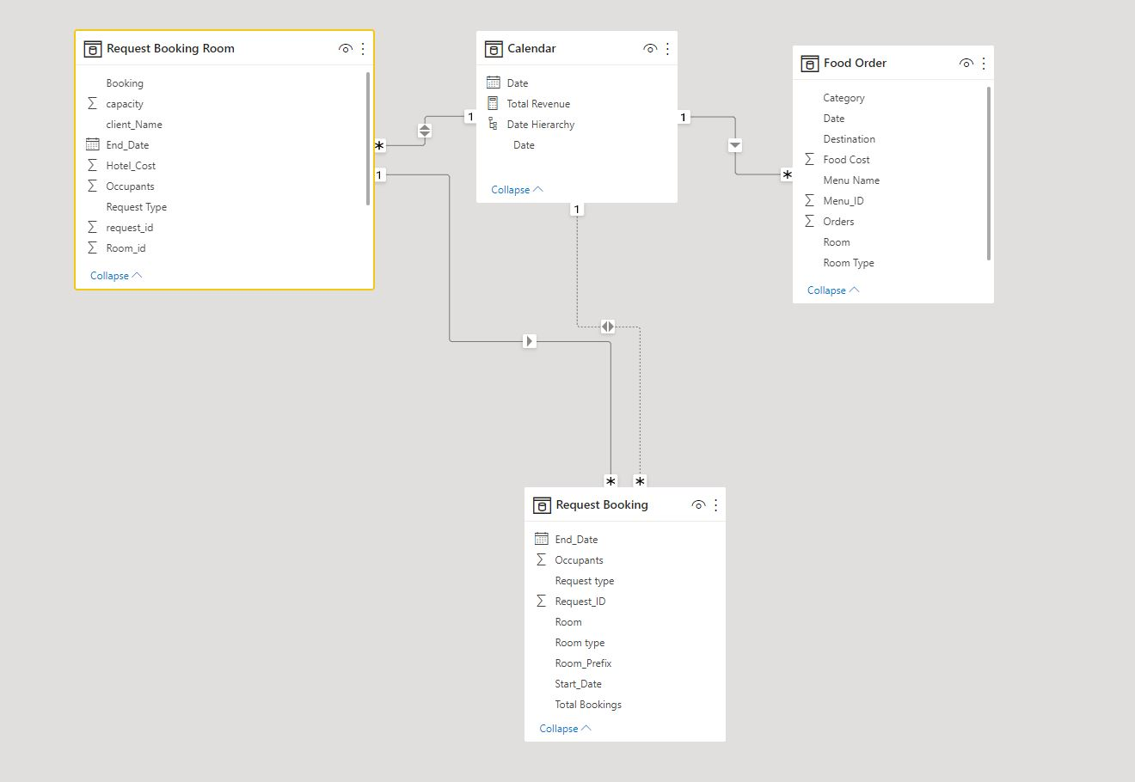
Design Consideration and ETL Transformation

Slide 6
Problem Statement to be solved using Business Intelligence tool
What type of room drove the highest demand?
What type of room generated the highest revenue?
What is the purpose for the most demand?
What period of the week had the most bookings?
What is the most demanded menu?
What period of the week and time of the day has the most food orders?
What type of room made the highest food order

Slide 7
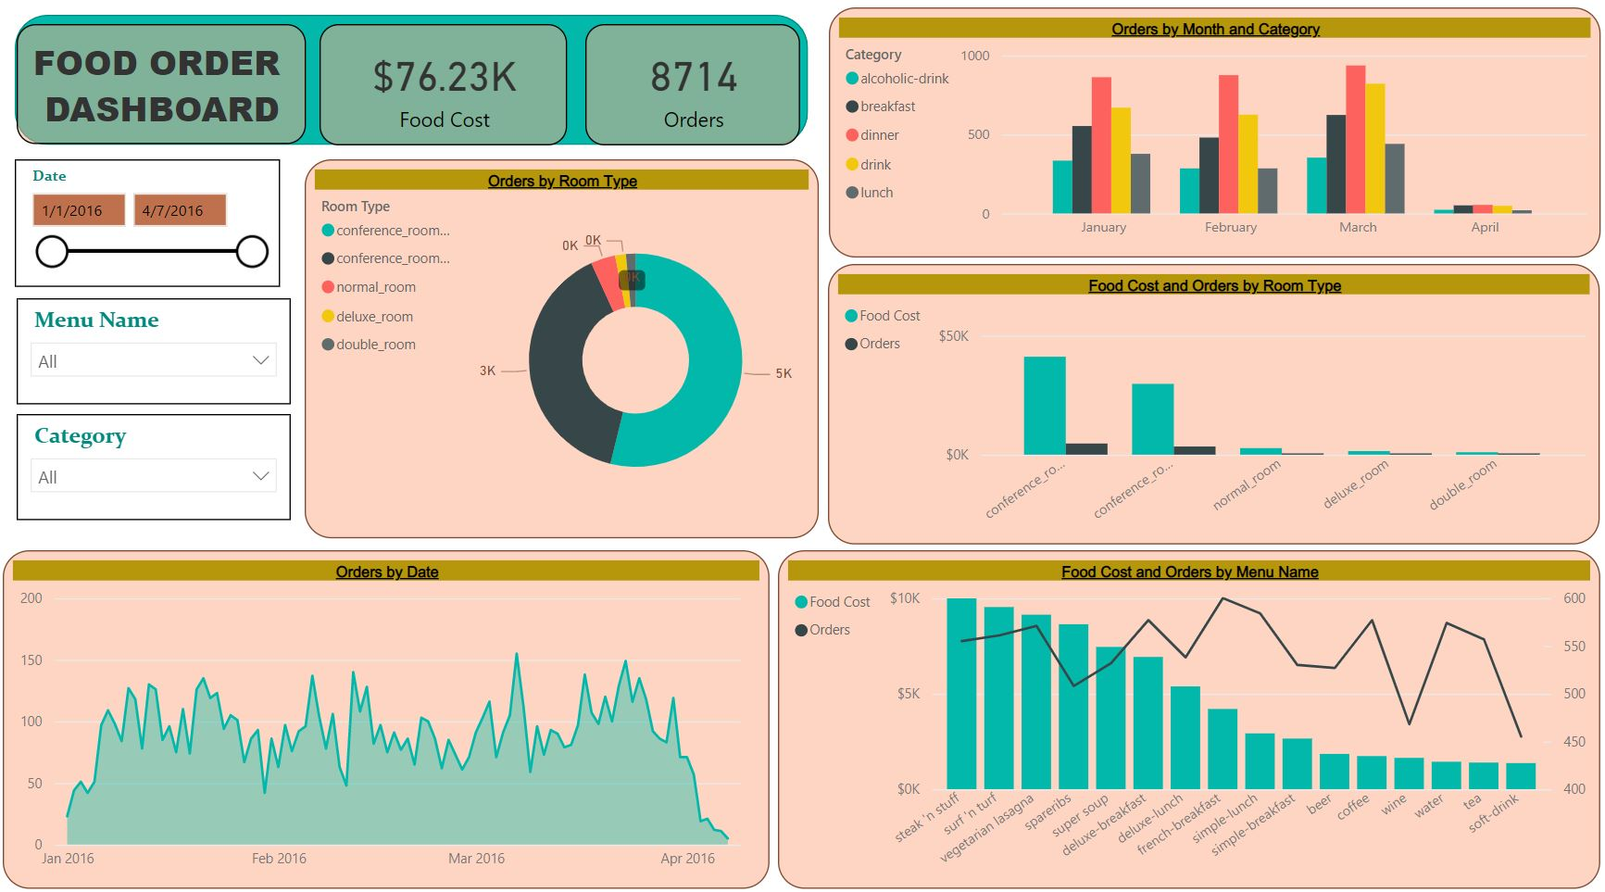
Food Order Dashboard

Slide 8
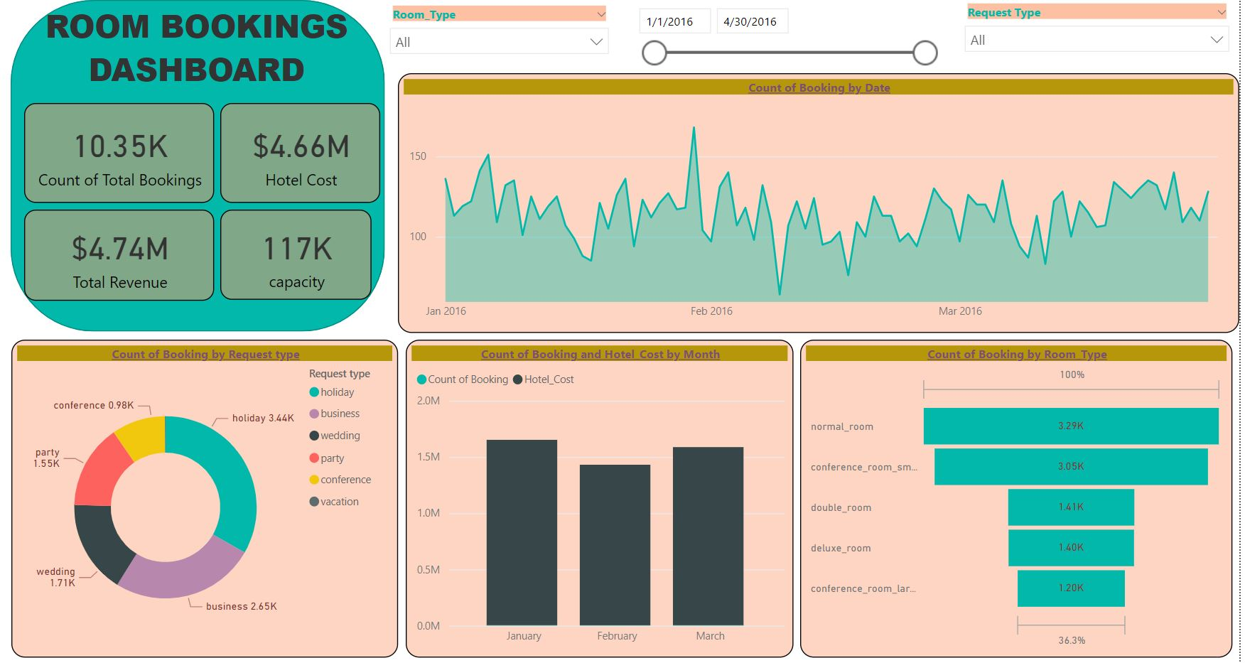
Room Bookings Dashboard

Slide 9


